Slide 1
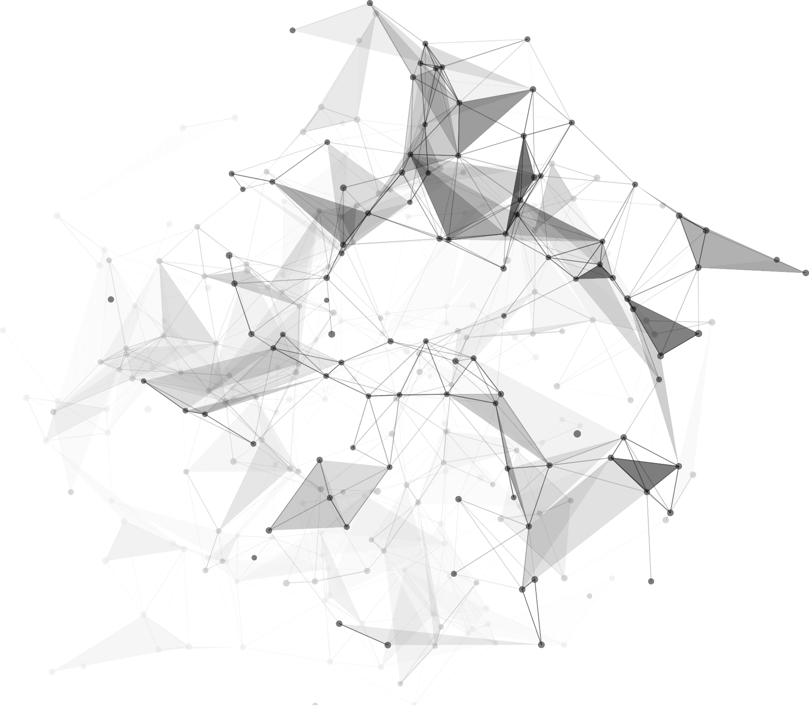
GenWardrobe: A Fully Generative System for Travel Fashion Wardrobe Construction
2025 ACM International Conference on Multimedia

Slide 2

01
Concept & Motivation
Motivation
Given the increasing consumer demand in both the travel and fashion industries, providing intelligent solutions for travel wardrobe construction carries substantial practical value.
Challenges:
⚠️ Lack of comprehensive integration of ‘human–complex context constraint–fashion knowledge’
⚠️ Underutilization of generative AI
Goal: Create an end-to-end system that understands ‘human–complex context constraint–fashion knowledge’ to generate travel fashion wardrobes.
Key Concept: Tripartite Modeling of ‘human–complex context constraint–fashion knowledge’
I’m traveling to Bali next week for a vacation, and after that, I’ll be attending a friend’s wedding in London. What kind of outfits should I wear for these occasions?

Slide 3
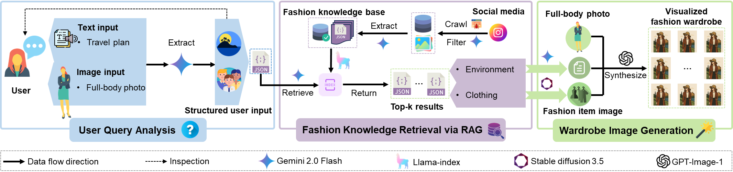
02
System Design & Workflow
System Design
👤 User Query Analysis
🔍 Fashion Knowledge Retrieval via RAG
🖼️ Wardrobe Image Generation

Slide 4
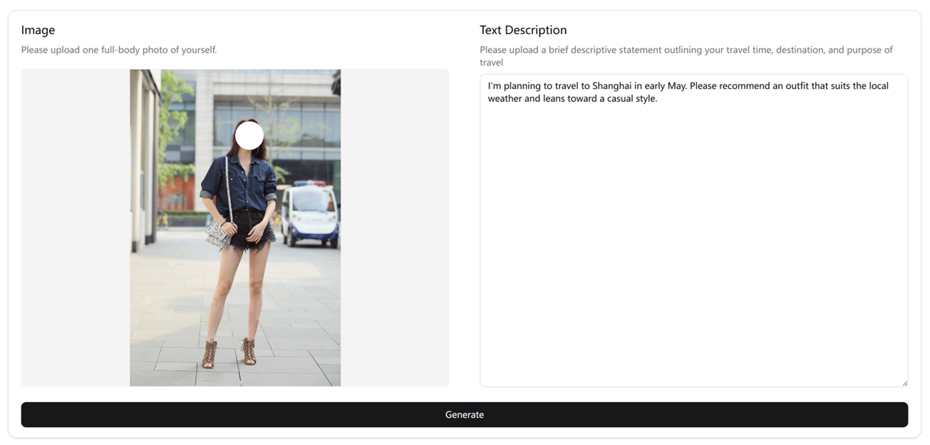


03
Implementation & Demo
1. User Query Analysis
Raw user input
Full-body photo
Travel plan
Structured user input
User personal attributes
Travel plan

Slide 5



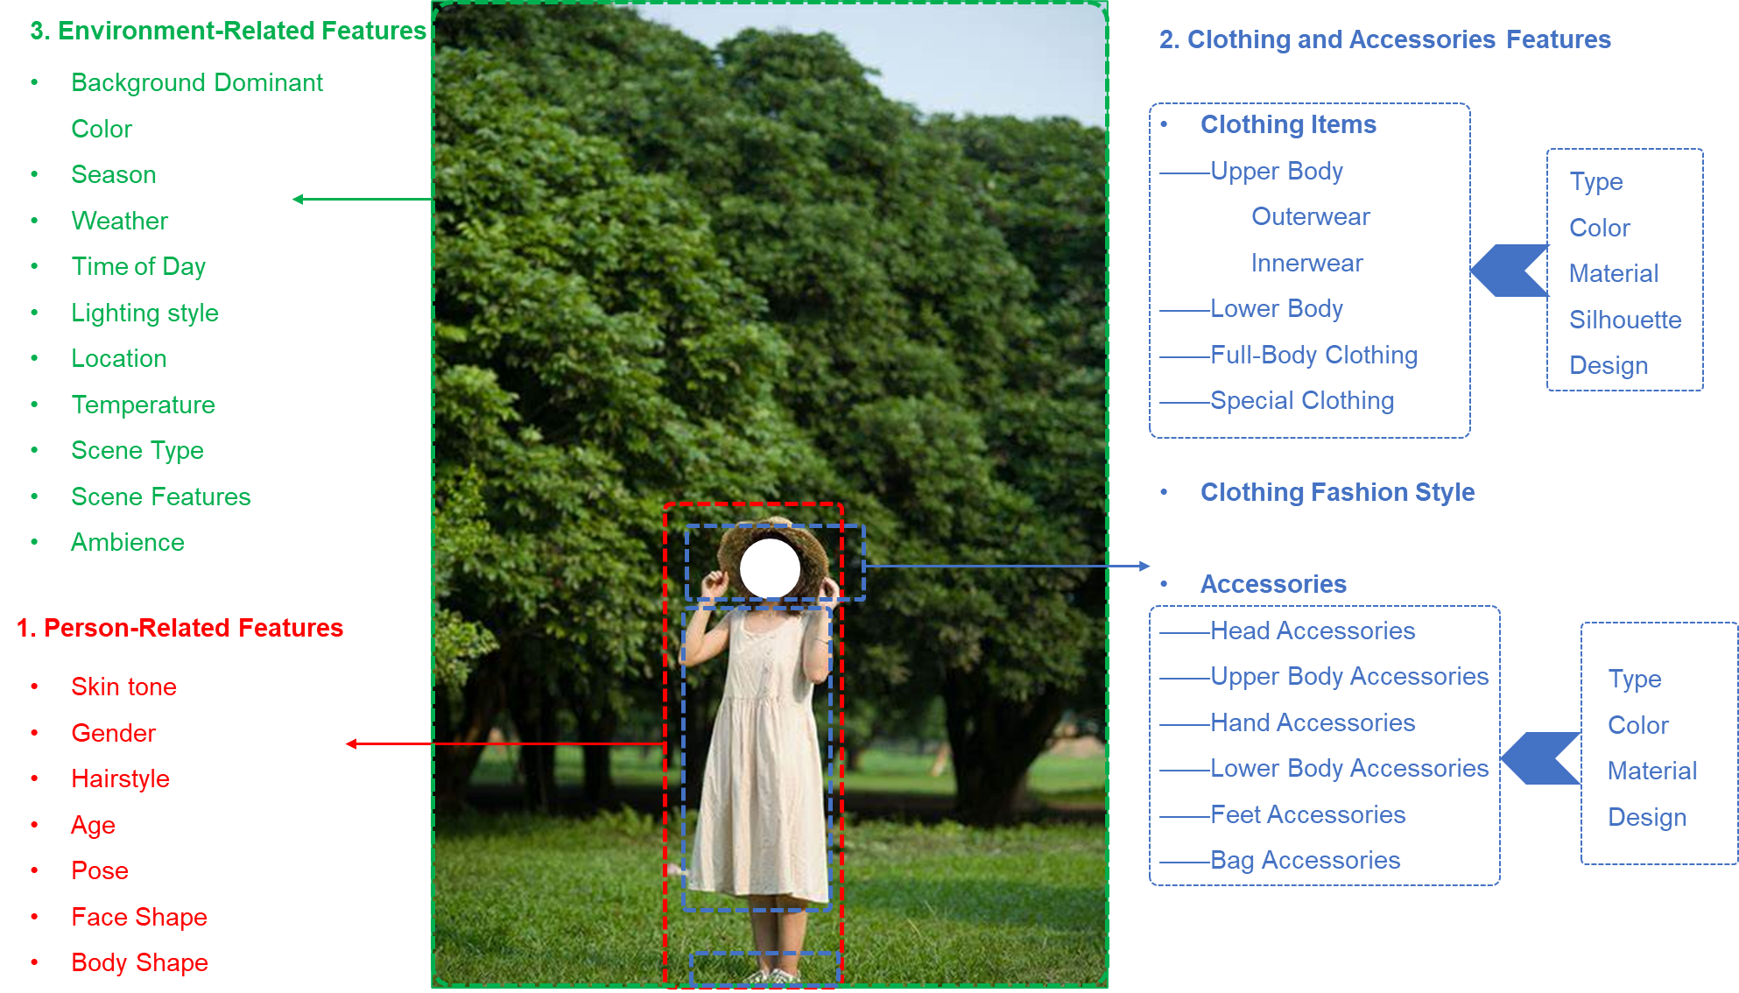







03
Implementation & Demo
2. Fashion Knowledge Retrieval via RAG: Fashion Knowledge Base Construction
Information Extraction Principles
We obtain a large fashion knowledge base with approximately one million pieces of fashion knowledge.
Social media
…
…
…
Crawl
Raw base
…
…
…
Filter
High-quality images base
…
…
Extract
Fashion knowledge base
…
…

Slide 6


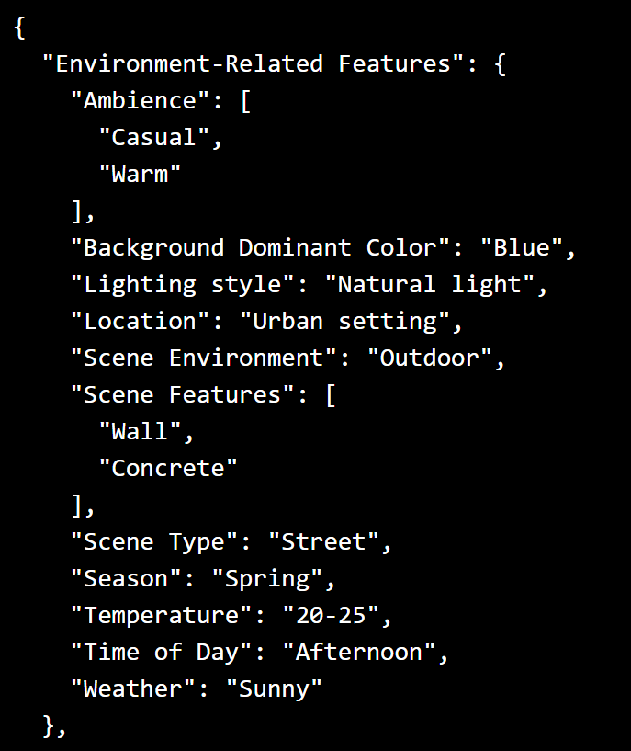
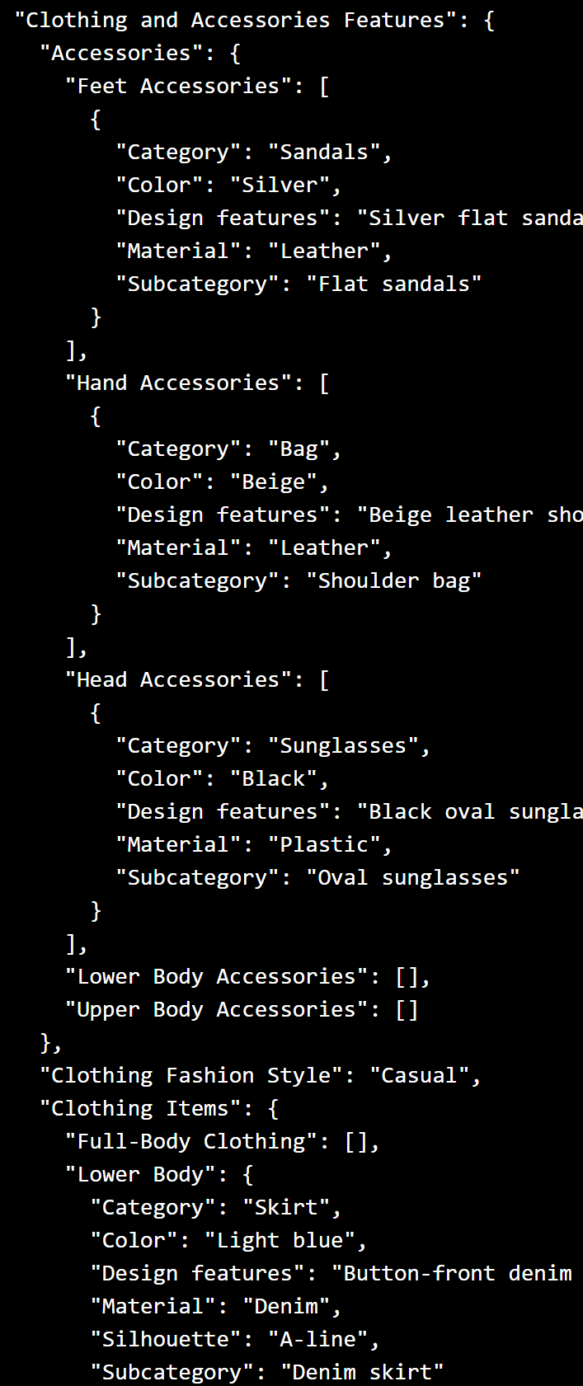



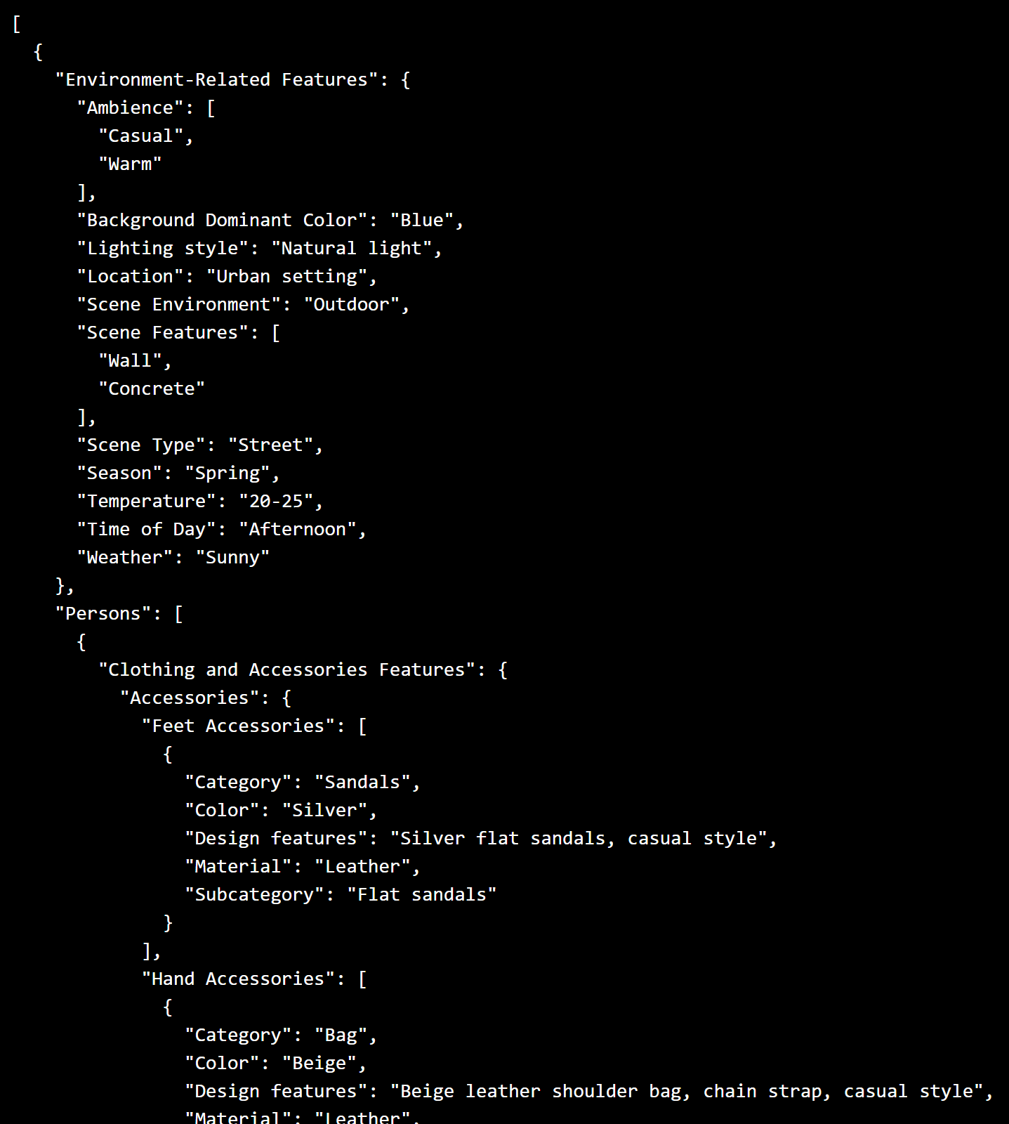
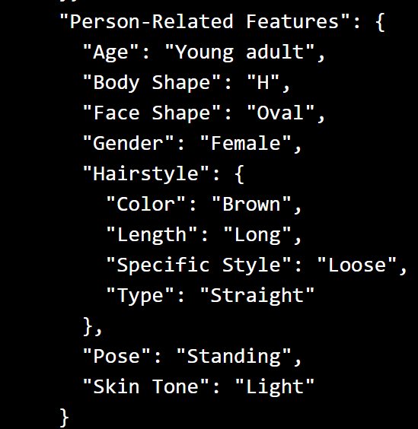
03
Implementation & Demo
2. Fashion Knowledge Retrieval via RAG:
Fashion Knowledge Retrieval
Environment information
Clothing information
Structured user input
Personal information
Travel plan
Retrieve
Fashion knowledge base
Top-k results
People
Environment
Clothing
Llama-index
Return
…
Top-k fashion knowledge

Slide 7
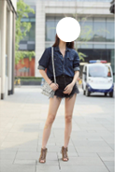
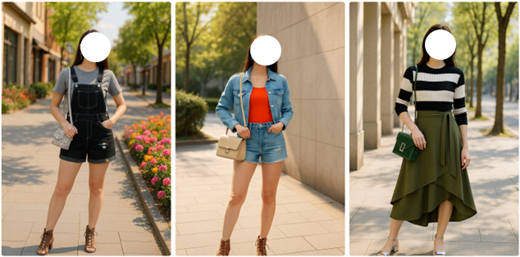
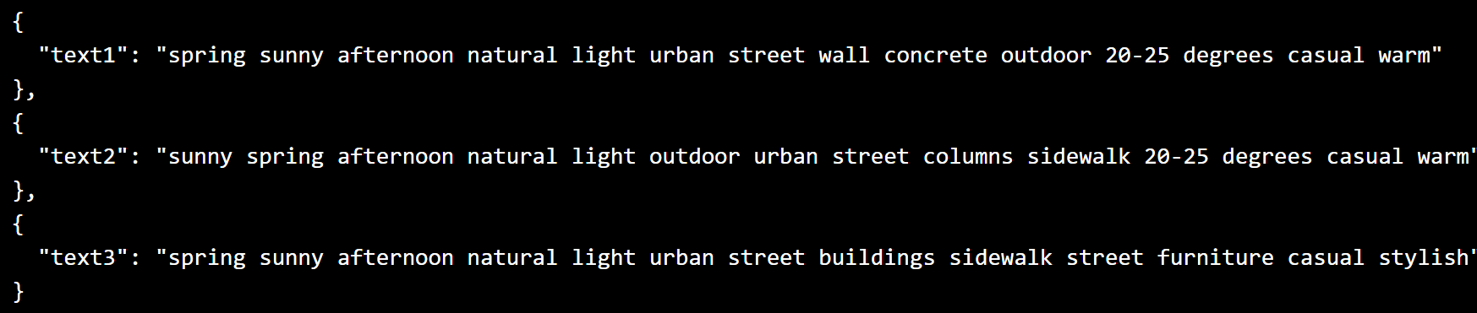

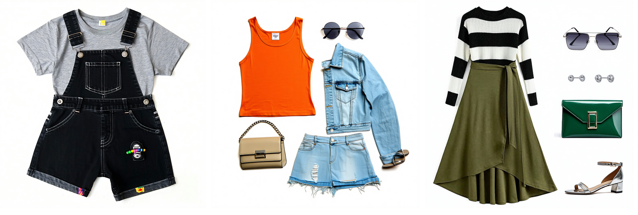

03
Implementation & Demo
3. Wardrobe Image Generation
(1) Full-body photo
Visualized fashion wardrobe
Top-k results
(2) Background description
Environment
information
Synthesize
(3) Fashion item image
Clothing
information

Slide 8
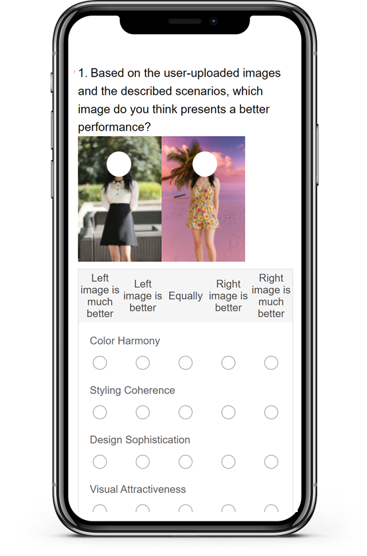
04
Evaluation
Evaluation Method: Based on the Academicism Aesthetic Test (AAT)
Primary Indicators | Secondary Indicators | Scoring Criteria
Aesthetic Appeal | 1 Color Harmony | Fritz 5-Level Rating (1–5 Likert scale) Used to score individual items on a 1 to 5 scale, where 1 is the least and 5 the most favorable. 2. Pairwise Comparison Method --5-Level Preference Intensity: Strong Preference A (Score: 5) Slight Preference A (Score: 4) Neutral (Score: 3) Slight Preference B (Score: 2) Strong Preference B (Score: 1)
 | 2 Styling Coherence
 | 3 Design Sophistication
 | 4 Visual Attractiveness
 | 5 Trendiness
 | 6 Proportional Harmony
Contextual Appropriateness | 7 Scene Fit
 | 8 Weather/Time Fit
Personalization | 9 Appearance Matching
 | 10 Style Matching
Visual Realism | 11 Clothing Fit Realism
 | 12 Facial Preservation
 | 13 Lighting & Blending

Slide 9
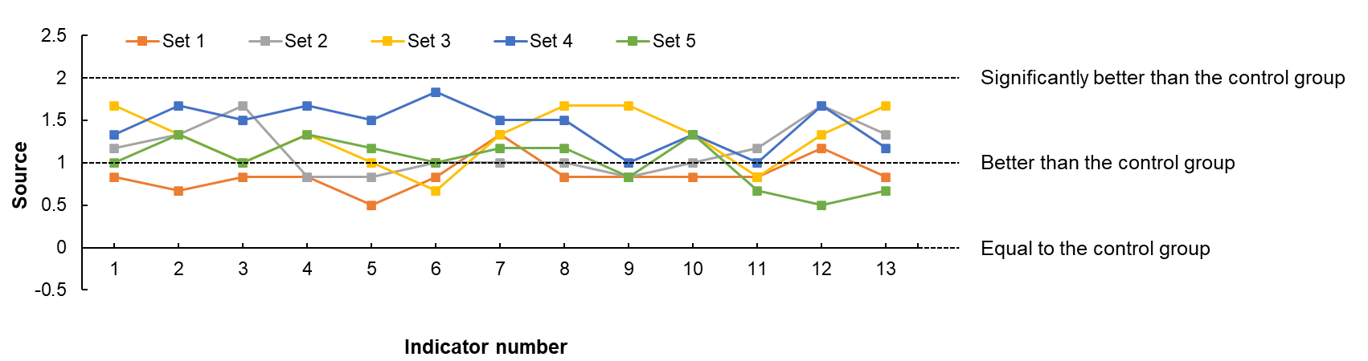
04
Evaluation
Five different people and scenarios
Set 1: General Travel Scenario
Set 2: Formal Event Scenario
Set 3: Leisure and Outdoor Activity Scenario
Set 4: Daily/Commuting Scenario
Set 5: Multi-task Scenario
5-point scale
+2 (“much better”)
+1 (“better”)
0 (“equal”)
-1 (“worse”)
-2 (“much worse”)
Six experts in the field of fashion
3 males
3 females

Slide 10

05
Conclusion & Future Work
Impact for MM Community
✅ Comprehensive Consideration of ‘human–complex context constraint–fashion knowledge’
✅ Multimodal Input: Image + text query
✅ Construction of a Large-scale Fashion Knowledge Base
✅ RAG for Fashion Knowledge Retrieval
✅ Synthesizing Body, Fashion Items, and Realistic Backgrounds
✅ Interactive User Interface via a Web Application
Future Work
🔮 Integrate AR/VR Try-on
🔮 Expand to Multi-day Outfit Planning, Event-based Dressing
🔮 Unlock New Value for E-commerce, Digital Wardrobe, and Virtual Stylists
Q: I’m traveling to Bali next week for a vacation, and after that, I’ll be attending a friend’s wedding in London. What kind of outfits should I wear for these occasions?
A: We can use GenWardrobe!!!

